Slide 1
TJAGLCS Training Package
Religious Accommodations
December 2024

Slide 2
The information provided throughout this training aid does not, and is not intended to, constitute legal advice; instead, all information, laws, statues, content, and materials for this training aid are for general informational purposes only. This training aid may not constitute the most up-to-date legal or other relevant legal information. Judge Advocates need to conduct their own due diligence through independent further legal research on any specific legal issue contained in this training package. No reader, user, or trainee of this product should act or refrain from acting based on information from this training aid without first seeking legal advice from an attorney in the relevant jurisdiction.

Slide 3
Religious Accommodations

Slide 4
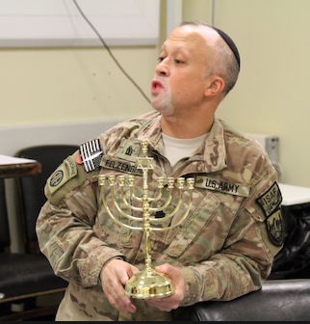
Religious Accommodation
The Army places a high value on rights of Soldiers to observe the tenants of their religion or to observe no religion at all
General Rules:
If request is a sincerely held religious belief OR duty substantially burdens religious exercise
Command may only deny if a compelling gov’t interest & is the least restrictive means of furthering the gov’t interest
If no sincerely held religious belief OR not substantial burden
Command only required to balance needs of Soldier against needs of mission accomplishment
Notes:
All from new 600-20 para 5-6 and Appendix P
Appendix P is a good/quick read

Slide 5
Religious Accommodation
Definitions:
Religious Exercise: Any exercise of religion, whether or not compelled by, or central to, a system of religious belief
Compelling Government interest could potentially include: safety, health, good order and discipline, uniformity, National Security, mission accomplishment
*Each request must be considered based on its unique facts

Slide 6
Religious Accommodation
Worship Practices
If involve use of prohibited substance (i.e., peyote, may require waiver of Army policy and only approved by SECARMY or designee
Dietary
Medical Care
TSG is approval or disapproval authority for immunization accommodation requests
Wear & Appearance of Uniform
Discreet items (yarmulke, necklace, metal bracelet) are authorized for wear w/o submitting a formal request
Other items (hijab, turban) require formal request
Personal Appearance & Grooming Practices
Formal request required to deviate from AR 670-1
Notes:
Worship, modesty, and dietary practices. Unit commanders are the designated decision authority for most worship and dietary practices

Slide 7
Religious Accommodation
Factors to Consider in Granting/Denying:
Importance of military requirements in terms of mission accomplishment military readiness, unit cohesion, good order, discipline, health, and safety
Importance of the accommodation to the requestor
Cumulative impact of repeated accommodations of a similar nature.
Measurable effect, if any, of granting the single accommodation requested
Does accommodation for one request result in the sanctioned discrimination of others
Alternative means available to meet the requested accommodation
Previous treatment of the same or similar requests,
including treatment of similar requests if made for other than religious reasons

Slide 8
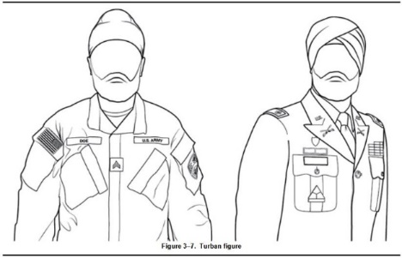
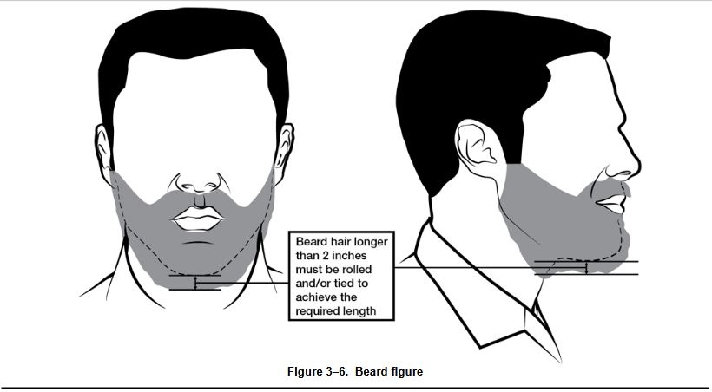
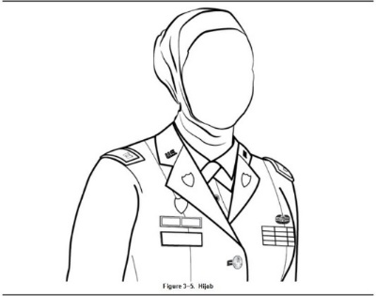
Religious Accommodation – Personal Appearance and Grooming
GCMCA can approve three uniform/appearance exception requests based on faith practices:
hijab
beard
turban or under-turban
Requests that require waiver of Army policy require only approved by SECARMY or Designee
Must reach HQDA (DCS G-1) within 30 days (60 days for USAR & ARNG)
Notes:
***CHANGE from former policy that allowed BDE Commanders to approve***
Once approved, GCMCA can review at any time for health and safety considerations
GCMCA of gaining command will review an approved accommodation upon a Soldiers PCS
Lots of Required coordination before acting on request:
OTJAG
DCS, G-1 Policy Division
OCC
Corrections Command (if applicable)
These images from 670-1

Slide 9
Need Training Materials?
Have Training Materials?
Questions?
Contact Us!
TJAGLCS-training@army.mil

